Slide 1
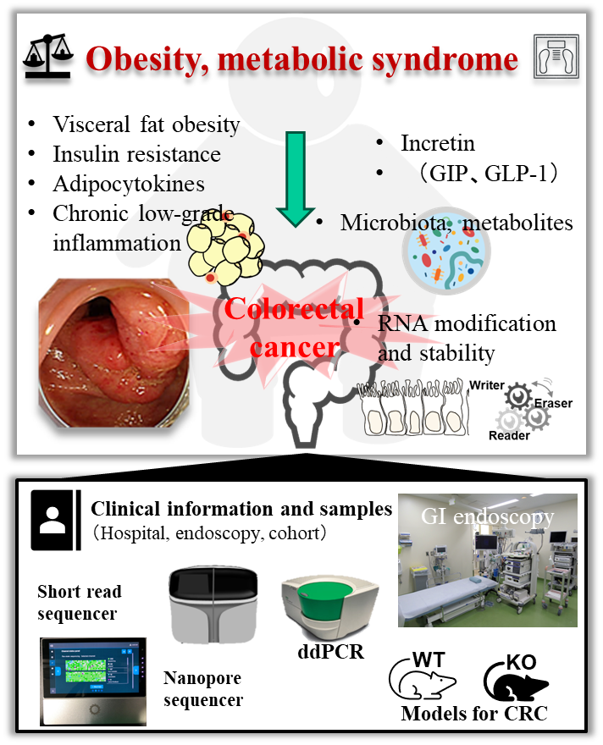
Elucidation of the mechanisms of obesity-related colorectal carcinogenesis
Lecturer Yu Sasaki, MD., PhD
Content：Obesity, metabolic syndrome, alcohol consumption, and smoking are major carcinogenesis risk factors, contributing to about 50% of global cancer deaths. Obesity and metabolic syndrome have notably increased in colorectal cancer (CRC) incidence. Our research has shown that metabolic alterations like insulin resistance, hyperinsulinemia, impaired adipocytokines and incretin secretion, chronic low-grade inflammation, gut microbiota, and pancreatic enzymes are involved in obesity-related CRC development. We’ve also found that post-transcriptional regulation and mRNA stability play a role in this process. We’ve identified a novel target gene and generated deficient mice models to further study the pathophysiology. Our goal is to devise new CRC prevention and treatment strategies by understanding individuals’ environmental exposures and metabolic changes at the molecular level, and to design lifestyles and exercise routines that promote healthy longevity.
Appealing point： Our research, both clinical and basic, is conducted using clinical information, gut microbiota and metabolite data from a large number of individuals. We actively promote interdisciplinary fusion and industry-academic collaborations!
Yamagata University, Faculty of Medicine
Research Interest ： Gastroenterology
E-mail ： y-sasaki@med.id.yamagata-u.ac.jp
Tel ： +81-23-628-5309
Fax ： +81-23-628-5311
HP ： https://www.id.yamagata-u.ac.jp/IntMedII/Gastro-Eng2003/index-e.htm

